Slide 1
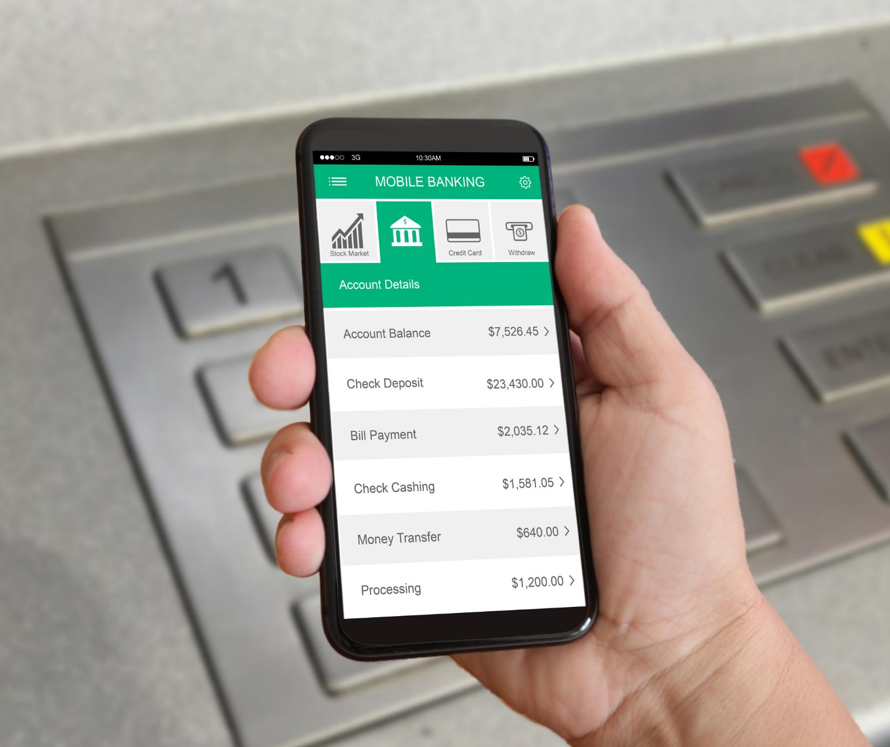
WF Agent Protocol By CreditAvengers
Sailesh Rudraraju
Prema Sai Kalivarapu
Prem Sai Bhumireddy
Hamsika Mannem
Notes:
AI-generated content may be incorrect. ---

Slide 2
Project Summary
Notes:
Overview of A2A Consumer Banking System

Slide 3

Overview of A2A Consumer Banking System
Agent-to-Agent Model
The system uses an Agent-to-Agent model to simulate real-time Line of Credit workflows between consumer and bank agents.
ESG Integration in Lending
ESG criteria are embedded into lending decisions, influencing interest rates with sustainability-focused discounts.
Secure Communication Protocol
The Wells Fargo Agent Protocol ensures secure, structured messaging and digital signature validation among agents.
Multi-bank Credit Processing
The platform processes corporate credit applications across five banks, each with distinct policies and priorities.
Notes:
The A2A Consumer Banking System is an advanced AI-powered platform designed to automate corporate credit processing across multiple financial institutions. It operates using an Agent-to-Agent (A2A) model, where a consumer agent interacts with several bank agents to simulate real-time credit application workflows. The system leverages Google's Agent Development Kit (ADK) to create intelligent agents capable of evaluating creditworthiness, negotiating loan terms, and applying ESG (Environmental, Social, and Governance) criteria to lending decisions. A key innovation of the system is its ability to process corporate credit applications simultaneously across five competing banks, each with distinct lending policies and ESG priorities. The platform integrates ESG metrics into interest rate calculations, offering sustainability-focused discounts based on carbon footprint and certifications. Secure communication between agents is facilitated by the Wells Fargo Agent Protocol (WFAP), ensuring structured messaging and digital signature validation. This system represents a significant step forward in automating financial services with a focus on sustainability and regulatory compliance.

Slide 4
Innovation & Business Value
Notes:
Advanced Features and Strategic Impact

Slide 5

Advanced Features and Strategic Impact
AI-Powered Negotiation
AI dynamically adjusts loan terms based on ESG performance and risk profiles to optimize lending decisions.
Secure Agent Communication
The WFAP protocol ensures secure and compliant communication between agents in the banking system.
Automated Multi-Bank Processing
Scalable platform automates credit processing across multiple banks, reducing manual work and turnaround time.
ESG-Focused Decisioning Framework
Sustainable lending practices aligned with corporate social responsibility goals drive strategic business value.
Notes:
The A2A Consumer Banking System showcases several cutting-edge innovations that enhance its strategic value in the financial sector. Key features include AI-powered negotiation capabilities, allowing dynamic adjustment of loan terms based on ESG performance and risk profiles. The system employs the Wells Fargo Agent Protocol (WFAP) for secure and structured agent communication, ensuring data integrity and compliance. From a business perspective, the platform enables scalable and automated multi-bank credit processing, significantly reducing manual effort and turnaround time. Its ESG-focused decisioning framework promotes sustainable lending practices, aligning with corporate social responsibility goals. The architecture is production-ready, featuring enterprise-grade security, error handling, and modular design for future enhancements. The system's extensibility supports integration with real financial institutions and regulatory frameworks, paving the way for industry-wide adoption. Overall, the A2A Consumer Banking System represents a transformative approach to corporate lending, combining technological excellence with sustainability and operational efficiency.

Slide 6
Implemented Capabilities from WFAP Protocol
Successful implementation of WFAP (Wells Fargo Agent Protocol)
Agent-to-agent negotiation and interaction
ESG scoring and carbon-adjusted interest rate evaluation
Secure communication using signed JSON packets
Audit and reasoning traces for both consumer and bank agents

Slide 7
Innovation & Business Value
Notes:
Advanced Features and Strategic Impact

Slide 8
Protocol specifications
Data Field | Description | Data Type
intent id | Unique identifier of this Intent (UUID) | string
created at | When the Intent was created (ISO8601 timestamp) | timestamp
nonce | Random value to prevent replay attacks | string
protocol_version | Protocol version (e.g., 'WFAP-1.0') | string
sender id | Unique organization identifier (DUNS, LEI, or internal ID) | string
sender_name | Company legal name | string
sender public _jwk_url | Location of public signing key (URL) | URL
sender_contact_email | Contact email for correspondence | email
purpose | Intended use of funds (e.g., 'working capital') | string
amount value | Requested amount | float
repayment duration | Length of facility in months | integer
repayment_ preference | interest_only / amortizing / bullet | string
preferred interest rate | preferred interest rate | float
drawdown_type | revolving / term, optional | string
collateral_description | Assets pledged as collateral, optional | string
company registration number | Incorporation number | string
jurisdiction | Country / state of incorporation | string
industry code | NAICS/SIC code | string
tax id | Tax ID (string or hashed) | string
financials annual revenue | Annual revenue | float
financials_net income | Net income | float
financials assets total | Total assets | float
financials liabilities total | Total liabilities | float
credit_report_ref | ID or token for external credit data, optional | string
esg certifications | ESG certifications (comma-separated) | list[string]
ese reporting url | ESG reporting URL, optional | URL
regulatory_context_jurisdiction | regulatory jurisdiction | string
regulatory context related disclosure | required disclosures | string
data_sharing_consent | true/false | boolean
signature | Digital signature | string

Slide 9
Architecture & Technology Stack
Notes:
System Architecture and Core Technologies

Slide 10
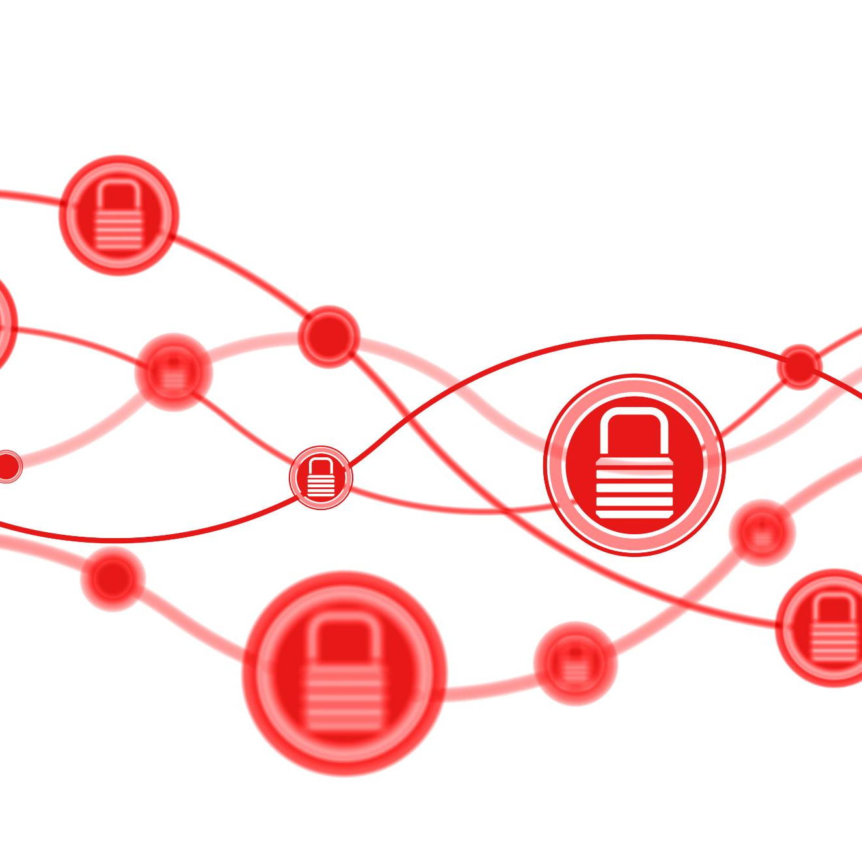
System Architecture and Core Technologies
Peer to Peer Architecture
The system uses a distributed peer-to-peer connecting consumer and bank agents.
Core Technologies and Frameworks
Python 3.12+, Flask, and Starlette/Uvicorn power the backend, supporting web and ASGI server frameworks.
Agent Communication and AI
Agent interactions use A2A SDK and Google's ADK, enabling AI-driven decision making and structured communication.
Security and Data Integrity
Security features include JSON-RPC messaging, digital signatures, token-based authentication, and data validation.
Notes:
The A2A Consumer Banking System is built on a distributed microservices architecture, comprising one consumer agent and five bank agents. The consumer agent operates on port 8000 and serves as the web-based interface for initiating credit applications. It coordinates with bank agents hosted on ports 10002 to 10006, each representing a different financial institution with unique lending strategies. These include CloudTrust Financial, Finovate Bank, Zentra Bank, NexVault Bank, and Byte Bank. The system uses Python 3.8+ as its primary programming language, with Flask and Starlette/Uvicorn providing the web and ASGI server frameworks. Agent communication is handled via the A2A SDK and Google's ADK, enabling structured interactions and AI-driven decision-making. Security is a critical component, with JSON-RPC facilitating agent messaging, and digital signatures ensuring data integrity. Additional technologies include Pydantic for data validation, JSONSchema for API validation, PyJWT for token-based security, and Cryptography for secure digital signatures. This robust tech stack supports scalable, secure, and intelligent financial operations.

Slide 11
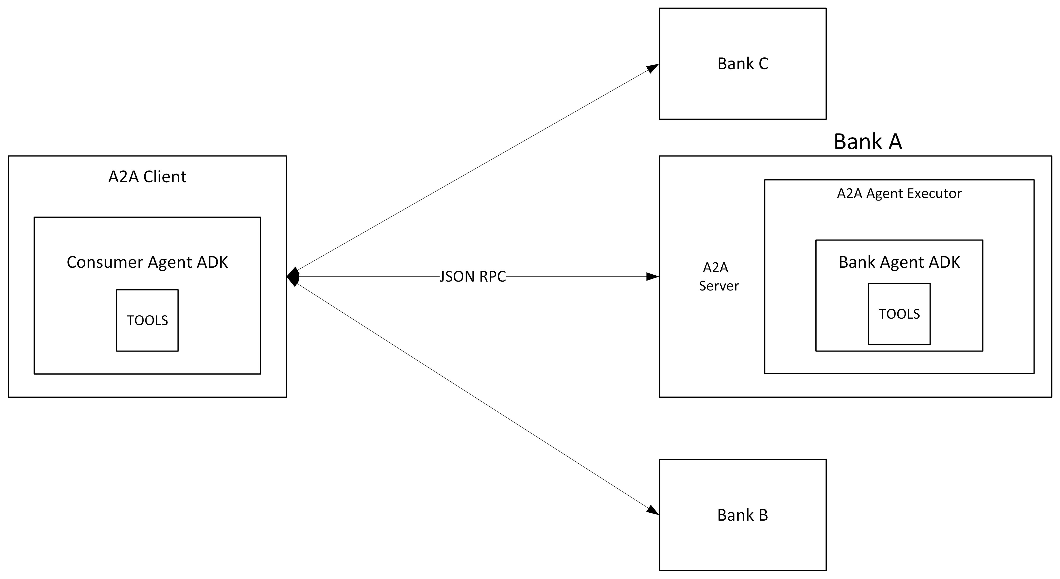
Communications Using A2A protocol

Slide 12
Credit Processing Workflow
Notes:
Automated Loan Processing Pipeline

Slide 13

Automated Loan Processing Pipeline
Initial Risk Assessment
Evaluates financial health indicators and verifies compliance and eligibility early in the loan process.
ESG Evaluation
Assesses carbon emissions and ESG certifications to calculate a sustainability score affecting loan rates.
Interest Rate Calculation
Combines base rate, risk premium, and ESG discounts to determine the final loan interest rate.
Automated Loan Offer Generation
Generates digitally signed loan offers including approved amounts, terms, and repayment durations.
Notes:
The credit processing workflow in the A2A Consumer Banking System is a multi-step pipeline designed to evaluate and approve corporate loan applications efficiently. It begins with an initial risk assessment, analyzing financial health indicators such as revenue, assets, liabilities, and industry-specific risks. Geographic compliance and basic eligibility are also verified at this stage. Next, the system conducts an ESG evaluation, which includes carbon emissions analysis (weighted at 70%) and validation of ESG certifications (weighted at 30%). This evaluation contributes to a sustainability score that influences interest rate calculations. The interest rate is determined by combining a base rate with a risk premium and subtracting an ESG discount, using a weighted risk score methodology. Once the interest rate is finalized, the system generates loan offers, calculating approved amounts, repayment durations, and compiling terms and conditions. Each offer is digitally signed to ensure authenticity. This automated pipeline enables real-time processing and comparison of loan offers from multiple banks, enhancing efficiency and transparency in corporate lending.

Slide 14
ESG Framework & Scoring
Notes:
Sustainability Scoring and Interest Rate Discounts

Slide 15

Sustainability Scoring and Interest Rate Discounts
ESG Score Composition
ESG scores combine 70% carbon performance and 30% qualitative factors like governance and certifications.
Interest Rate Discounts
Higher ESG scores earn interest rate discounts, incentivizing sustainable loan applicants effectively.
Supported Certifications
Certifications like B-Corp, ISO 14001, and LEED enhance qualitative ESG scores and credibility.
Real-Time ESG Reporting
Real-time ESG data fetching enables dynamic and up-to-date sustainability assessments for lending.
Notes:
The A2A Consumer Banking System incorporates a comprehensive ESG framework to assess the sustainability performance of loan applicants. The ESG score is calculated based on two primary components: carbon performance (70%) and qualitative factors (30%). Carbon performance evaluates industry-adjusted emissions intensity, while qualitative factors include certifications, governance practices, and sustainability reporting. Based on the ESG score, applicants receive interest rate discounts: ESG Leaders (score ≥90) receive a 0.75% discount, Strong Performers (≥75) get 0.50%, Average Performers (≥50) receive 0.25%, and Laggards (<50) do not receive any discount. Supported certifications include B-Corp, ISO 14001, SBTI, Carbon Neutral, LEED, and Fair Trade. The system also features real-time ESG report fetching from company URLs, enabling dynamic and up-to-date sustainability assessments. This ESG integration not only incentivizes environmentally responsible behavior but also aligns lending practices with global sustainability standards, making the system a pioneer in green financial technology.

